Slide 1
currency convertor
P. RUCHIKA 24KB1A05EL
M. MANASA 24KB1A05AU
P. AMRUTHA VARSHINI 24KB1A05EG
N.TEJASWI 24KB1A05BW

Slide 2
INTRODUCTION
In today’s globalized economy, currency conversion plays a vital role in international trade, travel, and finance. With increasing cross-border transactions, the need for quick and accurate currency conversion tools has become essential. This project presents a simple yet efficient Currency Converter system developed using the C programming language.
OBJECTIVES
The Currency Converter Code:
Implement a simple currency conversion tool using C
Convert between predefined currencies (USD, EUR, JPY, INR, GBP)
Use real-world exchange rates (static values in code)
Allow user input for source currency, target currency, and amount
Perform conversion based on relative rate to USD

Slide 3
Scope of the Project:
Supports conversion between five major currencies: USD, EUR, JPY, INR, and GBP
Allows user input for dynamic currency conversion
Maintains and displays a history of all conversions done during runtime
Uses static exchange rates for simplicity and offline functionality
Provides a menu-driven interface for ease of use
Technology used
Data Structures:
Arrays (for storing currency rates)
Structs (for currency and history records)
Linked List (for maintaining conversion history)
Concepts Applied:
Modular Programming
Dynamic Memory Allocation
String Handling (strcmp, strcpy)
Basic Input/Output (console-based)

Slide 4
Conversion Logic
Convert the source currency to USD:
amount_in_usd = amount / currencyRates[fromIndex]
Convert USD to target currency:
converted_amount = amount_in_usd * currencyRates[toIndex]
Example:
Convert 100 EUR to INR:
EUR rate: 0.85, INR rate: 74.5
Result = 100 * (74.5 / 0.85) ≈ 8764.71 INR
challenges Faced:
Fixed Currency List:
Users cannot add, remove, or update currencies without modifying the code, limiting flexibility.
No User Guidance on Errors:
When an invalid input is entered (like an out-of-range index), the program shows a generic message but doesn't guide the user on how to correct it

Slide 5
Future enhancements :
Improved Input Validation:
Enhance the input checks to handle invalid or non-numeric inputs, preventing the program from crashing or behaving unexpectedly.
Customizable Currency List:
Allow users to add new currencies or modify exchange rates at runtime, making the program more flexible without changing the code
Users interface design:
Main menu
Currency conversion input
conversion result
conversion history
errors handling

Slide 6
Coding:
https://onlinegdb.com/YxJr1vu0Lz

Slide 7
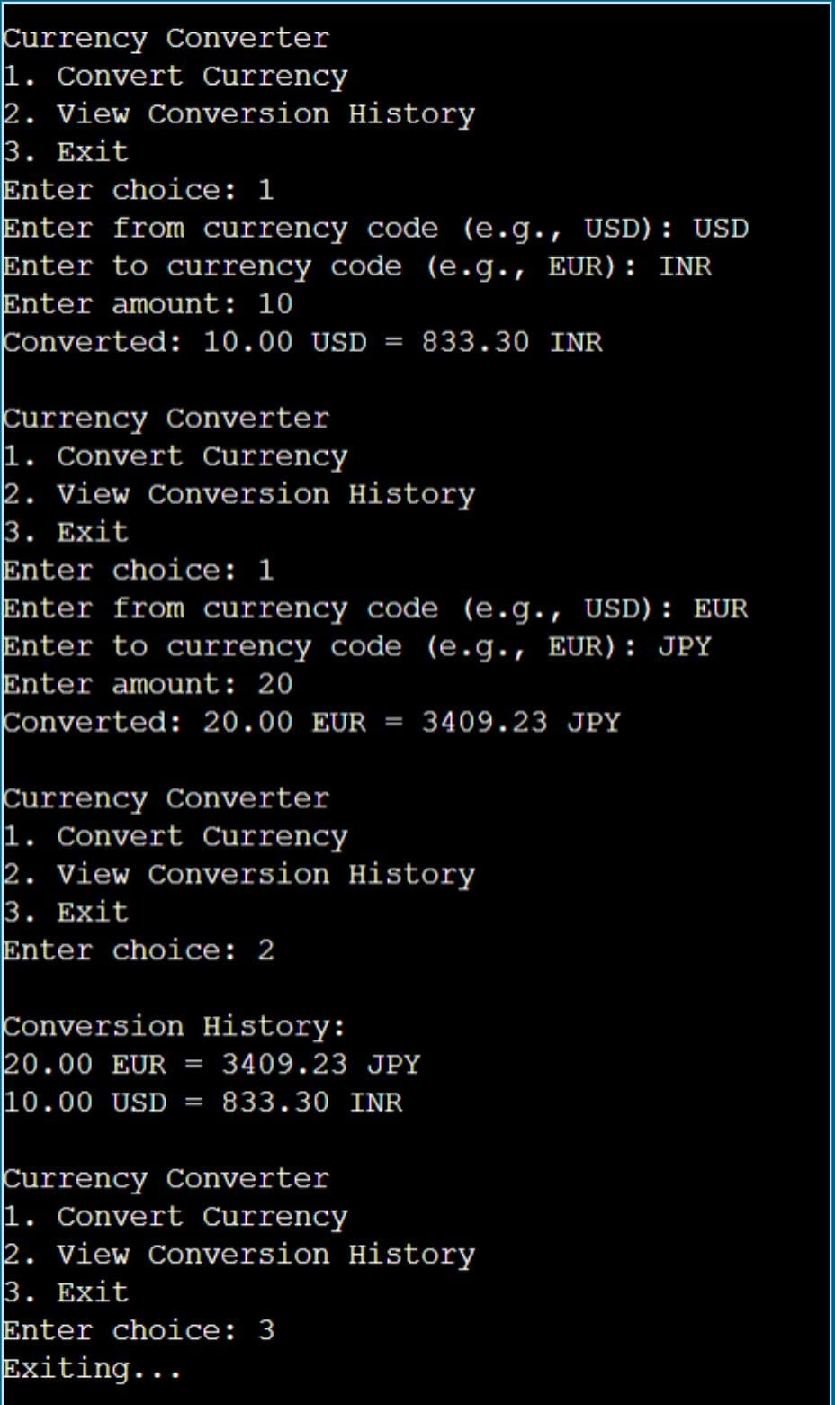
Output:

Slide 8
Conclusion:
1. The program successfully performs currency conversions and keeps a history of all conversions, allowing users to track their past actions.
2. To improve the tool, adding features like error handling for invalid inputs, dynamic currency list updates, and saving history to a file would make it more robust and user-friendly.

Slide 9
THANK YOU

